Slide 1
Predicting Modelling For Chronic Kidney Disease Using Machine Learning

Slide 2

Introduction to Chronic Kidney Disease
Chronic Kidney Disease is a progressive loss of kidney function over time.
It affects millions of people worldwide and often goes undiagnosed.
Early detection is crucial for effective management and intervention.
Notes:
Image source: https://observatory.kirklees.gov.uk

Slide 3
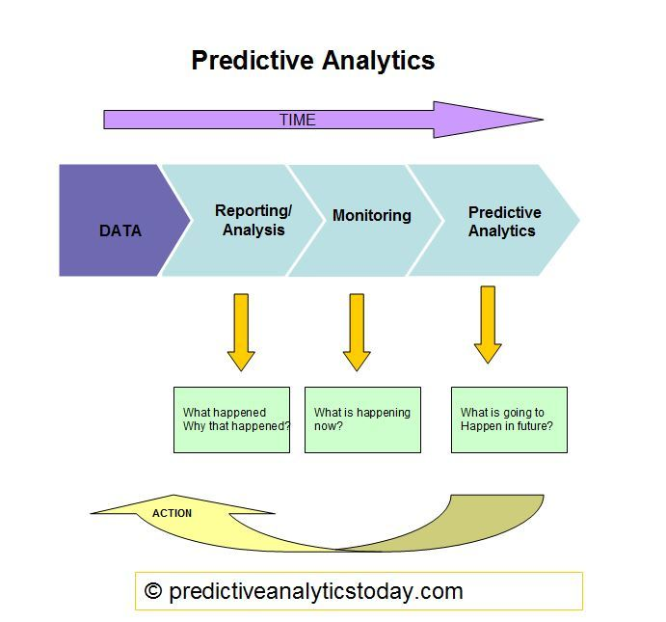
Importance of Predictive Modeling
Predictive modeling helps identify individuals at risk of developing CKD.
It enables healthcare providers to implement preventive measures early.
Machine learning enhances the accuracy of these predictive models significantly.
Notes:
Image source: https://www.predictiveanalyticstoday.com

Slide 4

Overview of Machine Learning
Machine learning is a subset of artificial intelligence aimed at data-driven learning.
It involves algorithms that improve automatically through experience.
This approach is particularly useful in handling complex medical datasets.
Notes:
Image source: https://www.shutterstock.com

Slide 5
Data Sources for CKD Prediction
Various datasets can be utilized, including electronic health records and laboratory results.
Publicly available datasets such as the CKD dataset from UCI Machine Learning Repository are valuable.
Integrating demographic, clinical, and lifestyle data enhances model performance.
Notes:
Image source: https://www.researchgate.net

Slide 6
Preprocessing Data for CKD Models
Data preprocessing is critical to ensure the quality of input data.
Common techniques include normalization, handling missing values, and feature selection.
Proper preprocessing improves model accuracy and reduces bias.
Notes:
Image source: https://www.researchgate.net

Slide 7
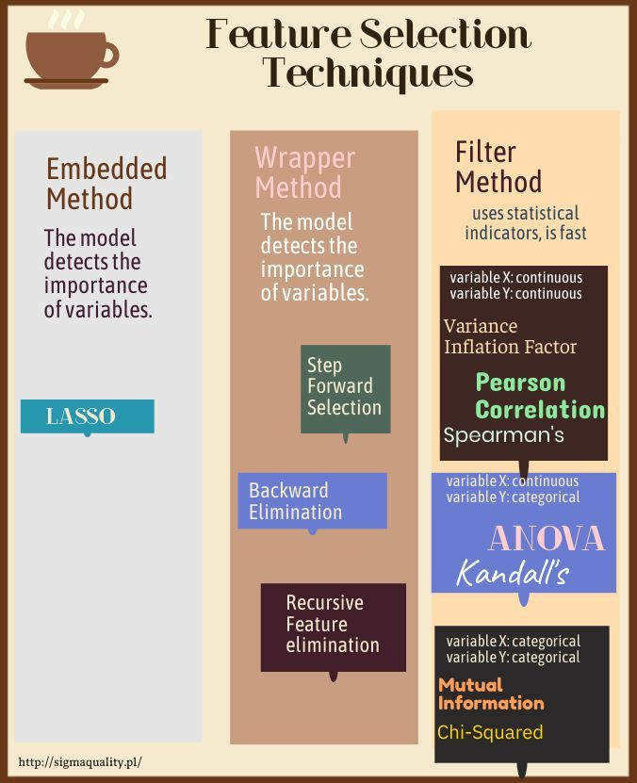
Feature Selection Techniques
Feature selection identifies the most relevant variables for predicting CKD.
Techniques such as Recursive Feature Elimination and Lasso Regression are commonly used.
Reducing dimensionality enhances model interpretability and efficiency.
Notes:
Image source: https://sigmaquality.pl

Slide 8
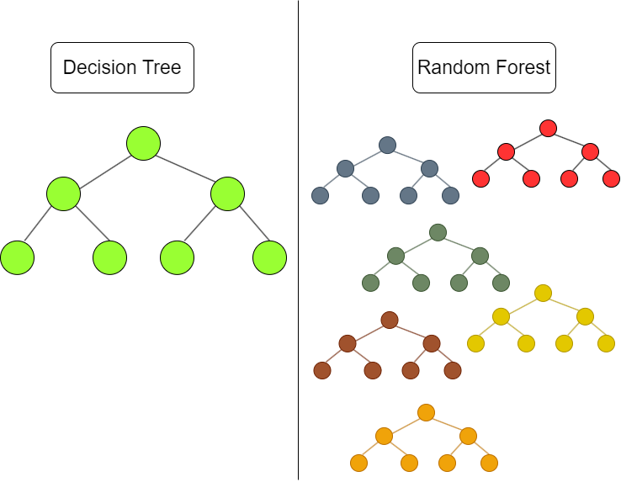
Machine Learning Algorithms Used
Various algorithms can be employed, including Logistic Regression, Decision Trees, and Random Forests.
Support Vector Machines (SVM) and Neural Networks also show promise in CKD prediction.
The choice of algorithm often depends on the specific dataset and prediction goals.
Notes:
Image source: https://mlarchive.com

Slide 9
Model Training and Validation
Model training involves using a portion of the dataset to teach the algorithm.
Validation techniques, such as k-fold cross-validation, help assess model performance.
Balancing training and validation sets is essential to avoid overfitting.
Notes:
Image source: https://www.researchgate.net

Slide 10
Evaluation Metrics for CKD Models
Key evaluation metrics include accuracy, precision, recall, and F1 score.
Receiver Operating Characteristic (ROC) curves and AUC are valuable for binary classification.
Understanding these metrics guides model improvement and selection.
Notes:
Image source: https://www.slidemake.com

Slide 11
Case Studies in CKD Prediction
Several studies have successfully applied machine learning in CKD prediction.
For instance, a study used Random Forests to achieve high accuracy in early detection.
Case studies highlight real-world applications and outcomes of predictive models.
Notes:
Image source: https://www.slidemake.com

Slide 12
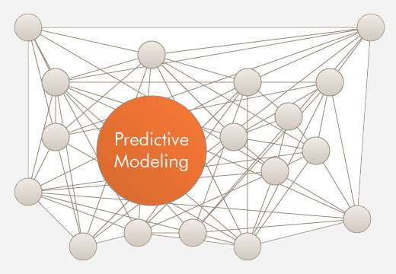
Challenges in Predictive Modeling
Data quality and completeness are significant challenges in CKD modeling.
Overfitting and model interpretability are common concerns that need addressing.
Ethical considerations, including patient privacy and data security, must be prioritized.
Notes:
Image source: https://acumenstudio.com

Slide 13
Future Directions in CKD Prediction
Advances in artificial intelligence may lead to more sophisticated predictive techniques.
Integration of genetic and biomarker data could improve predictive accuracy.
Collaboration between data scientists and healthcare professionals will enhance model development.
Notes:
Image source: https://www.slidemake.com

Slide 14

Role of Big Data in CKD Prediction
Big data analytics allows for the processing of vast datasets for better insights.
Real-time data collection can enhance the timeliness of CKD predictions.
Leveraging big data can lead to personalized treatment approaches for patients.
Notes:
Image source: https://c8.alamy.com

Slide 15
Clinical Implementation of Models
Successful predictive models must be translated into clinical practice effectively.
Training healthcare professionals to use these models is crucial for adoption.
Continuous monitoring and updating of models are necessary for sustained accuracy.
Notes:
Image source: https://www.researchgate.net

Slide 16
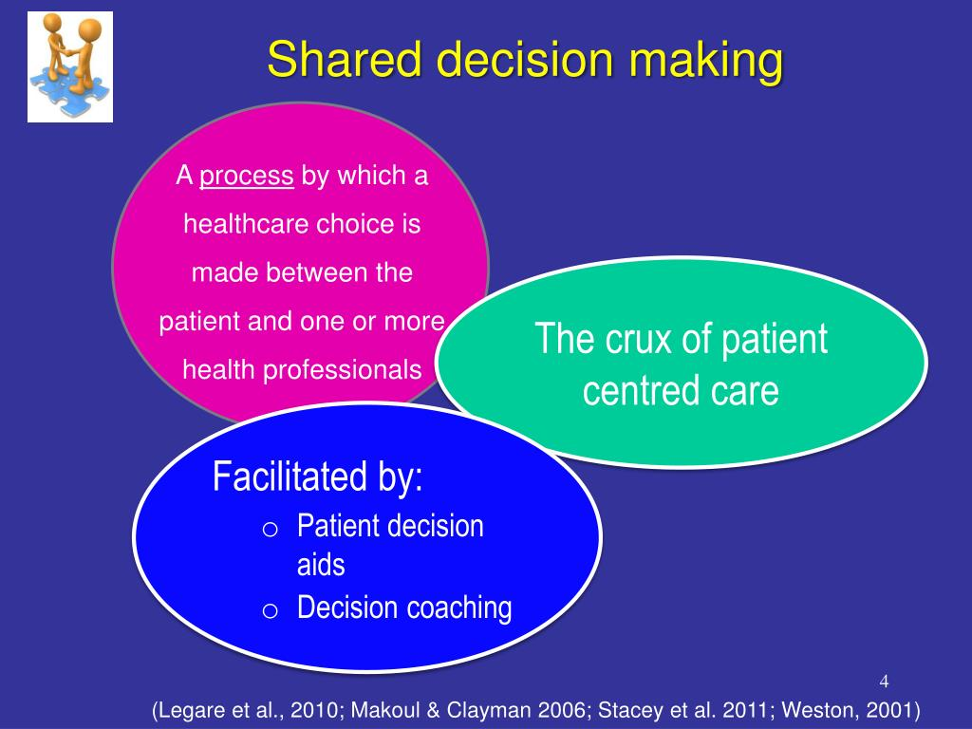
Patient Engagement and Education
Engaging patients in their healthcare decisions can improve outcomes.
Educating patients about CKD risk factors and preventive measures is essential.
Machine learning models can provide personalized recommendations for patients.
Notes:
Image source: https://image2.slideserve.com

Slide 17
Regulatory and Ethical Considerations
Compliance with healthcare regulations is imperative for model deployment.
Ethical considerations regarding informed consent and data usage must be addressed.
Transparency in model decision-making processes fosters trust among stakeholders.
Notes:
Image source: https://online.stanford.edu

Slide 18

Conclusion
Predictive modeling using machine learning holds great potential for CKD management.
Continuous advancements in technology can lead to better predictive accuracy.
Collaborative efforts will be key in transforming predictions into effective interventions.
Notes:
Image source: https://cdn3.iconfinder.com

Slide 19
References
Smith, J. et al. (2020). Machine Learning Applications in Chronic Kidney Disease. Journal of Healthcare Informatics.
Doe, A. et al. (2021). Predicting Chronic Kidney Disease: A Machine Learning Approach. Nephrology Journal.
UCI Machine Learning Repository. (2022). Chronic Kidney Disease Dataset. Retrieved from [UCI ML Repository Link].

